Slide 1
Credit Card Fraud Detection using LightGBM and TabNet
Machine Learning Based Financial Security System
Dataset: Credit Card Transactions (creditcard.csv)
Domain: Banking & Financial Technology
Prepared by: Prashant Kumar
Department: Computer Science & Engineering

Slide 2
Introduction & Motivation
Rapid growth of digital payments has increased financial fraud risks
Credit card fraud causes major losses to banks and customers
Manual fraud detection is slow and error-prone
Machine learning enables automated, accurate, and scalable fraud detection
Goal:
To identify fraudulent credit card transactions with high precision and recall

Slide 3
Problem Statement
Fraud detection is a binary classification problem
Transactions are classified as:
Legitimate (0)
Fraudulent (1)
Key challenges:
Highly imbalanced dataset
Complex and evolving fraud patterns
Need for high reliability

Slide 4
Dataset Description
Dataset contains anonymized credit card transactions
Features:
  Numerical transaction attributes
  Transformed using PCA for privacy
Target variable:
  Class = 0 → Normal transaction
  Class = 1 → Fraudulent transaction
Key Observation:
Fraud cases are extremely rare compared to normal transactions

Slide 5
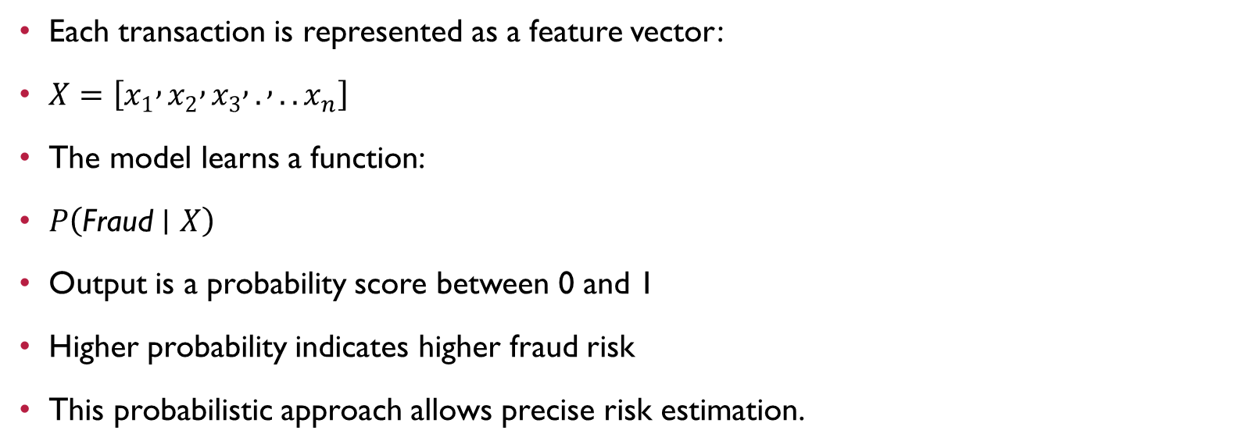
Mathematical Intuition
Each transaction is represented as a feature vector:
$X=\left[x_{1} , x_{2} , x_{3} , . , ..x_{n}\right]$
The model learns a function:
$P\left(\text{Fraud}∣X\right)$
Output is a probability score between 0 and 1
Higher probability indicates higher fraud risk
This probabilistic approach allows precise risk estimation.

Slide 6
LightGBM Model Overview
Gradient Boosting Decision Tree algorithm
Builds multiple trees sequentially to minimize prediction error
Optimizes log-loss for classification tasks
Advantages:
High accuracy on tabular data
Fast training and inference
Handles class imbalance effectively
Widely used in real-world banking systems.

Slide 7
TabNet Model Overview
Deep learning model designed for tabular datasets
Uses attention mechanism to focus on important features
Learns feature interactions automatically
Advantages:
High interpretability compared to traditional neural networks
Captures complex fraud patterns
Strong performance on structured financial data

Slide 8
Model Training & Evaluation
Dataset split into training and testing sets
Models trained independently:
  LightGBM
  TabNet
Evaluation metrics used:
  Precision
  Recall
  F1-score
  ROC–AUC
Reason:
Accuracy alone is misleading for imbalanced fraud data.

Slide 9
Results & Comparison
LightGBM:
  Faster training
  Strong baseline performance
TabNet:
  Better feature learning
  Deep representation capability
Both models successfully identify fraudulent transactions with high ROC–AUC scores.

Slide 10
Conclusion & Future Scope
Conclusion:
Machine learning provides an effective solution for fraud detection
LightGBM and TabNet complement each other
System is suitable for real-world financial applications
Future Scope:
Real-time fraud detection systems
Explainable AI integration
Deployment using web or cloud platforms

